Slide 1

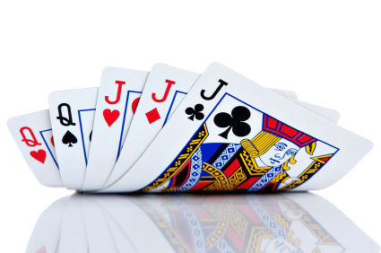
Advanced (ish)
Counting and Probability
Math Club 10/31/2011

Slide 2

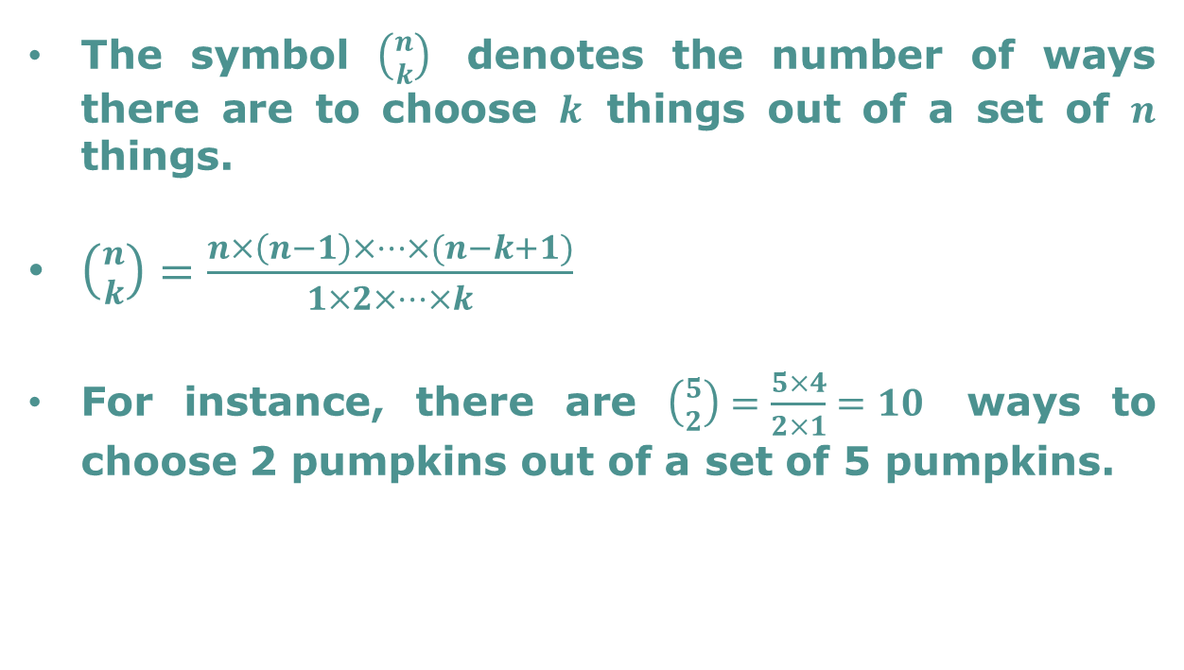
Choosing from a set
The symbol $\left({n \atop k}\right)$ denotes the number of ways there are to choose $k$ things out of a set of $n$ things.
$\left({n \atop k}\right)=\frac{n×\left(n−1\right)×⋯×(n−k+1)}{1×2×⋯×k}$
For instance, there are $\left({5 \atop 2}\right)=\frac{5×4}{2×1}=10$ ways to choose 2 pumpkins out of a set of 5 pumpkins.

Slide 3
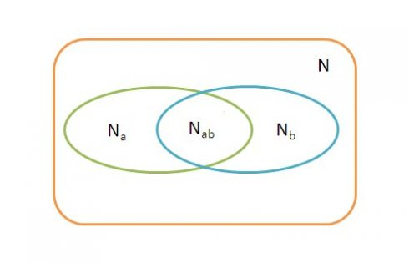
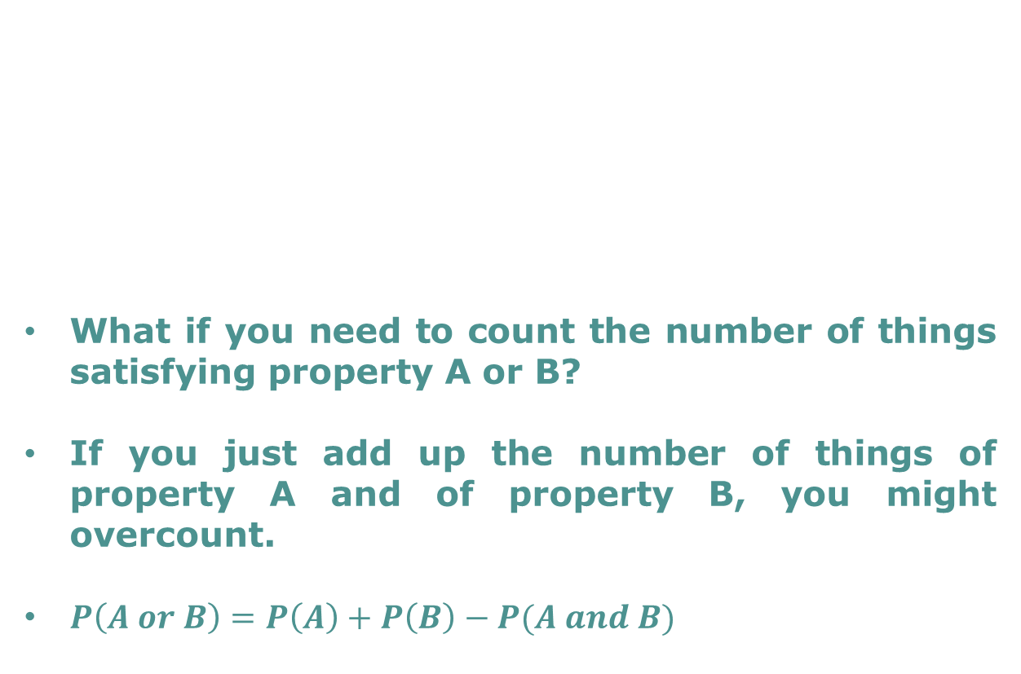
Inclusion Exclusion Principle
What if you need to count the number of things satisfying property A or B?
If you just add up the number of things of property A and of property B, you might overcount.
$P\left(A or B\right)=P\left(A\right)+P\left(B\right)−P(A and B)$

Slide 4
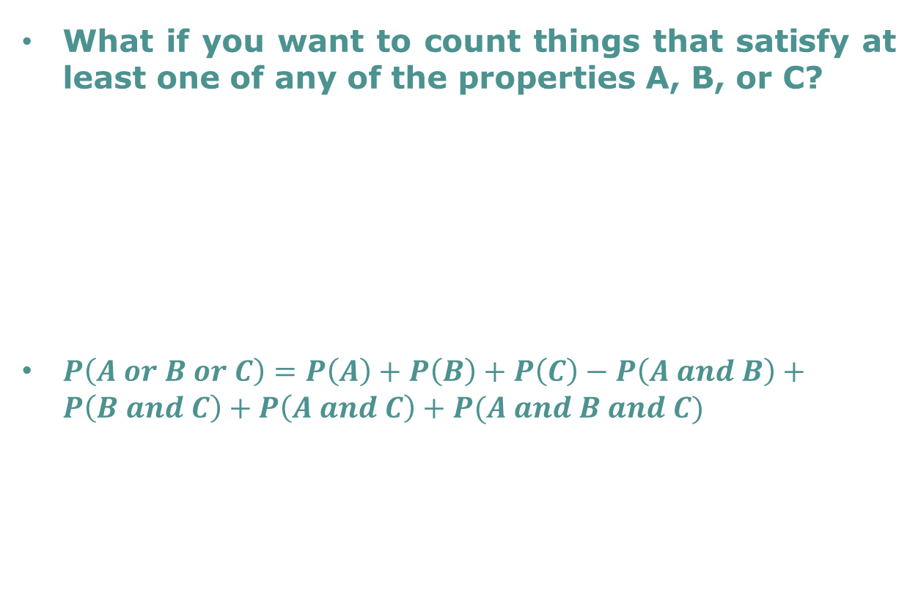
Inclusion Exclusion Principle
What if you want to count things that satisfy at least one of any of the properties A, B, or C?
$P\left(A or B or C\right)=P\left(A\right)+P\left(B\right)+P\left(C\right)−P\left(A and B\right)+P\left(B and C\right)+P\left(A and C\right)+P(A and B and C)$

Slide 5
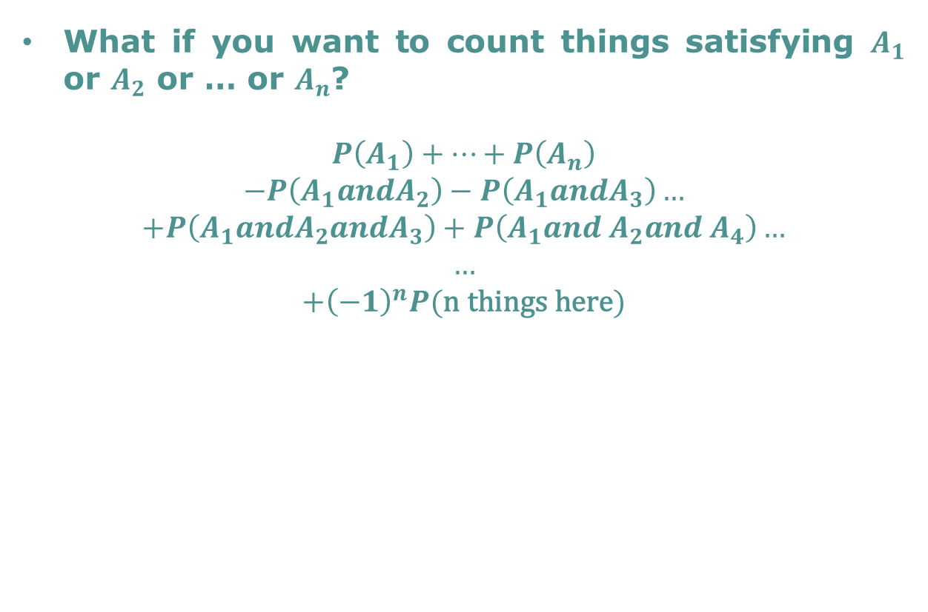
Inclusion Exclusion Principle: Pattern?!
What if you want to count things satisfying $A_{1}$ or $A_{2}$ or … or $A_{n}$?
$$P\left(A_{1}\right)+…+P\left(A_{n}\right)$$
$$−P\left(A_{1}andA_{2}\right)−P\left(A_{1}andA_{3}\right)…$$
$$+P\left(A_{1}andA_{2}andA_{3}\right)+P\left(A_{1}and A_{2}and A_{4}\right)…$$
$$…$$
$$+{\left(−1\right)}^{n}P(\text{n} \text{things} \text{here})$$

Slide 6
Easy Problem (Poker Probabilities)
A set of five playing cards is considered a full house if it contains three cards of one rank and two cards of another rank.
What is the probability that five random cards is a full house?

Slide 7
Easy Problem (Project Euler 1)
What is the sum of all the positive integers below 1000 that are divisible by 3 or 5?

Slide 8
Easy Problem (AIME 2011 II #12)
Nine delegates from three countries (three delegates per country) sit at a round table. What’s the probability that everyone sits next to at least one person from a different country?

Slide 9
Problem of The Day
I take two shuffled decks of 52 cards each, and for 52 turns deal one card from each deck simultaneously. What’s the chance that at some point the two cards are the same?

